Slide 1

e: principal@sdbroadmeadows.catholic.edu.au
w: https://www.sdbroadmeadows.catholic.edu.au
St. Dominic’s School promotes the safety, wellbeing and inclusion of all children.
May 10th 2021
Term 2 Week 4
Dear families and friends of St. Dominic’s,
In yesterday’s Gospel at Church, we heard words from John’s Gospel- “Love one another.” The model for this love is the love that Jesus showed towards all who followed him. We are called to express this love in our interactions with each other each day. Wishing all the wonderful mums, grandmothers and mother figures in our community a very happy Mother’s Day for yesterday, and remembering those in heaven.
A big thank you to all our helpers at Friday’s Mother’s Day Breakfast celebration and at our Mother’s Day Gift Stall. They are big events to organise and coordinate but the reward is always wonderful.
St. Dominic’s School continues to extend its thoughts and prayers to those families affected by the current Covid-19 situation in India and in other parts of the world.
Excursions: We are very lucky here at St. Dominic’s to offer our students comprehensive excursions which are aimed to help with student learning. Often, we ask for parent helpers to attend the excursion to assist with supervision. Parent helpers must have a current Working with Children Check (WWC) and younger siblings are not able to attend. It is usual practice for teachers to ask for 2 parents per class to assist-if there are more than 2 parents who would like to help, the names are drawn from a hat.
School Photo Day is next Thursday May 20th- all students should be in full school uniform on this day-please contact the office if you have any queries about photos. There is no expectation that families purchase photos. All students will still have their photo taken.
This week our Year 3 and 5 students will undergo NAPLAN testing. NAPLAN is a nationwide point-in-time assessment that allows parents to see how their child is progressing against literacy and numeracy standards and over time. NAPLAN tests are only one aspect of a school’s assessment and reporting progress and do not measure the overall quality of a school. These tests do not reflect the skill set qualities of our learners. We say, “Just do your best and we will be VERY proud of you.”
Have a great week- Alison ☺

Slide 2

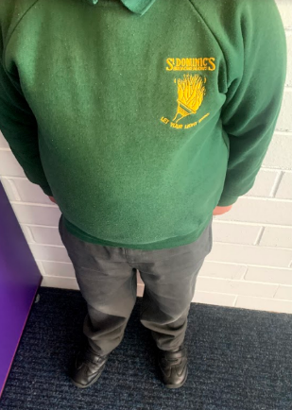
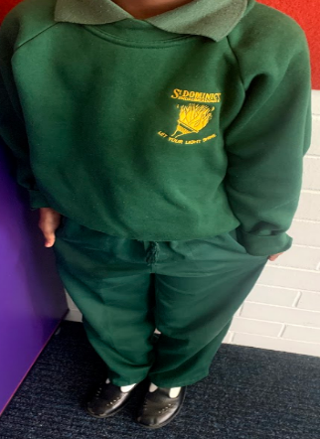
e: principal@sdbroadmeadows.catholic.edu.au
w: https://www.sdbroadmeadows.catholic.edu.au
St. Dominic’s School promotes the safety, wellbeing and inclusion of all children.
Year 6 families should now be finalising their arrangements for which secondary school they will be attending in 2022, such as Penola Catholic College, Mercy College, or other government secondary schools such as Hume Central Secondary College. If you need any help please contact Ms Bretag at school.
What is the Nationally Consistent Collection of Data? Schools must now complete the Nationally Consistent Collection of Data on School Students with Disability (NCCD) every year. It counts the number of students who receive additional adjustments or “help” at school because of a disability. The NCCD helps governments plan for the needs of students with disability.
Once the school decides that the student should be counted in the NCCD, they then choose a disability group and one of four levels of help that has been given to the student. In the NCCD the word ‘disability’ comes from the Disability Discrimination Act 1992 (DDA). There are four types of disability that the school can choose from: sensory, cognitive, social-emotional and physical.
Many students that need help at school can be counted in the NCCD. For example, students with learning problems, e.g. specific learning disability or reading difficulty (sometimes called dyslexia), health problems (e.g. epilepsy or diabetes), physical disability (e.g. cerebral palsy), vision/hearing loss and social-emotional problems (e.g. selective mutism, Autism Spectrum Disorder, anxiety).
Don’t forget to use the Skoolbag app to read the newsletter and inform the school of student absences.
Boys
Girls
Students should be in winter uniform in Term 2

Slide 3
e: principal@sdbroadmeadows.catholic.edu.au
w: https://www.sdbroadmeadows.catholic.edu.au
St. Dominic’s School promotes the safety, wellbeing and inclusion of all children.
OUR VALUES AWARDS-WEEK 2
Class | Students
Prep M | Declan | Liza
Prep N | Margarita | Hunter
1I | Jessica N | Riyana
1J | Eliana Y | Mansirat
2K | Lam | Claudia
2L | Allyson | Ruby
3/4O | Prabhas | Rami
3/4P | Klark | Luka
3/4Q | Aaron | Onel
5/6H | Lurans
5/6R | Yousif Q
5/6S | Ninos
Mrs Burnett | Elena G | Nirmandeep
Miss Sharon | - | -
Miss Baba | Hendrix | Qaynath
Miss Rebecca
Let your light shine award:

Slide 4
e: principal@sdbroadmeadows.catholic.edu.au
w: https://www.sdbroadmeadows.catholic.edu.au
St. Dominic’s School promotes the safety, wellbeing and inclusion of all children.
OUR VALUES AWARDS-WEEK 3
Class | Students
Prep M | Charbel | Vera
Prep N | Jessie G | Mirella K
1I | Adelpha Benjamin | Angel Fernando
1J | Irene X | Samaveer S
2K | Liron S | Kresteen K
2L | A ntonella | Rose
3/4O | Joy | Virjinia
3/4P | Glory A | Jaswanth
3/4Q | Eliana | Marcie
5/6H | Mario. M | Chelsea. S
5/6R | Mark S | Farah A
5/6S | Nancy | Shane
Mrs Burnett | Ekjot | Joshua M
Miss Sharon | Layth G | Yousif Q
Miss Baba | Zane T | Jaycob M
Miss Rebecca
Let your light shine award: Mario M, Joshua M, Farah, Yousif Q, Jaycob M, Liron

Slide 5

e: principal@sdbroadmeadows.catholic.edu.au
w: https://www.sdbroadmeadows.catholic.edu.au
St. Dominic’s School promotes the safety, wellbeing and inclusion of all children.
Term 2 Important Dates
 | TERM 2 CALENDAR Some important dates for the coming weeks (more to come)
May 11th, 12th, 13th | NAPLAN testing-All Year 3 and Year 5 students
May 13th | Prep Zoo Excursion
May 14th | Year 5/6H and R Science Excursion
May 20th | 6pm-Sacrament of Confirmation
May 28th | Year 5/6S Science Excursion
June 1st | Year 5/6 to Science works
June 10th | Year 1 Zoo excursion
June 14th | Queen’s Birthday Public Holiday-no school for students
June 21st-24th | Life Education Van incursion
June 25th | Last day of Term 2
Like us on Facebook-
St. Dominic’s Catholic Primary School Broadmeadows
Sports uniforms to be worn only on the following days:
Prep- Tuesday
Year 1- Monday
Year 2- Friday
Year 3/4- Tuesday
Year 5/6- Monday ,Wednesday,Friday

